Slide 1
Metadata for Research Data Curation: Design, Select, and Adapt.

Slide 2
Agenda
Metadata for data curation
Evaluating standards
Using existing standards
Develop your own
Application Profiles

Slide 3
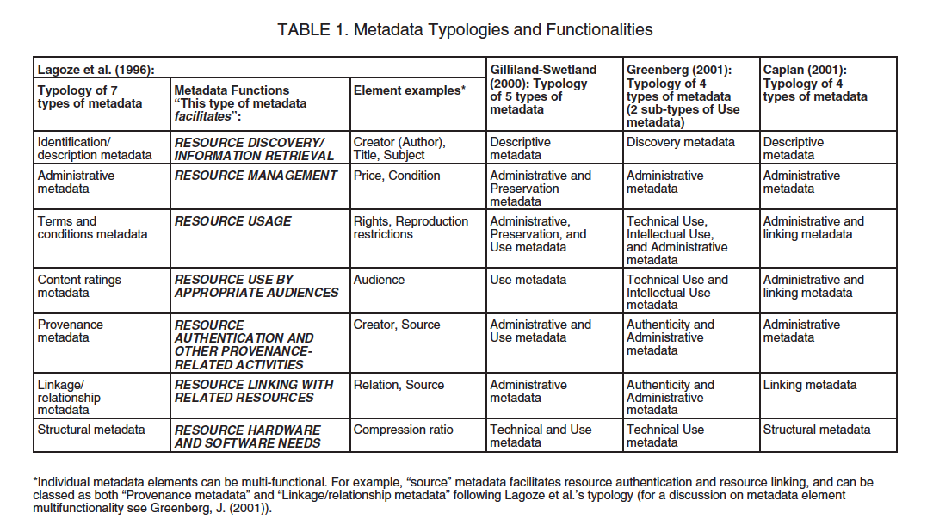
Notes:
There are holy wars over just this topics

Slide 4
Types of Metadata
Descriptive
Structural
Administrative
Rights Management
Preservation
NISO. (2004) Understanding Metadata. Bethesda, MD: NISO Press, pp.1-2.
Notes:
NISO. (2004) Understanding Metadata.
Bethesda, MD: NISO Press, pp.1-2.

Slide 5
Descriptive Metadata
… describes a resource for purposes such as discovery and identification. It can include elements such as title, format, author (s), keywords, spatial coverage, date, etc.

Slide 6
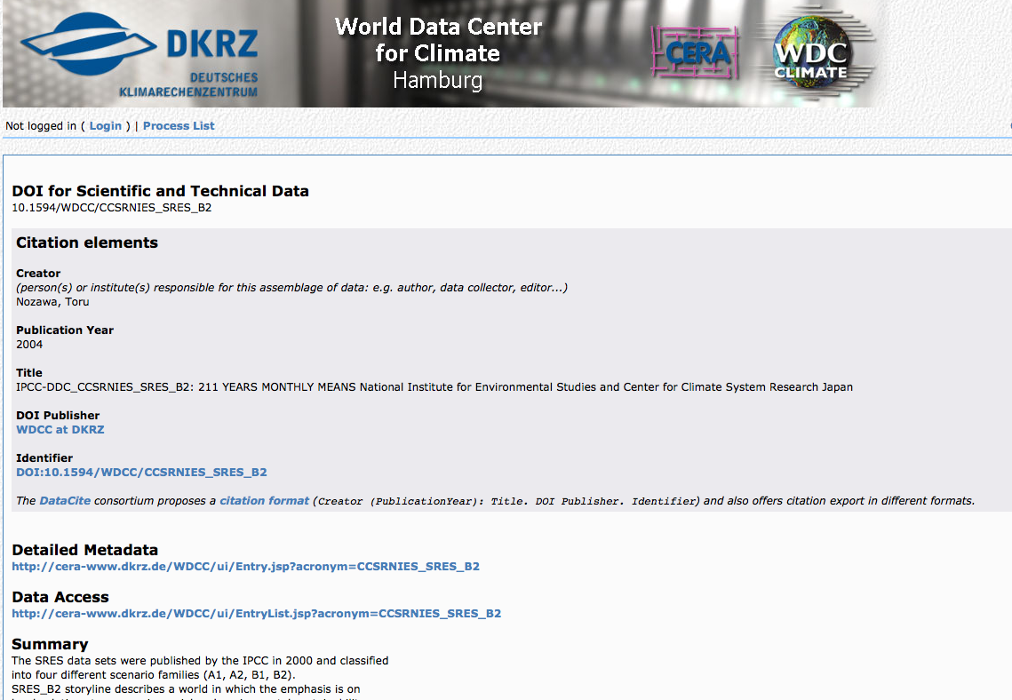
Example
http://cera-www.dkrz.de/WDCC/ui/Compact.jsp?acronym=CCSRNIES_SRES_B2

Slide 7
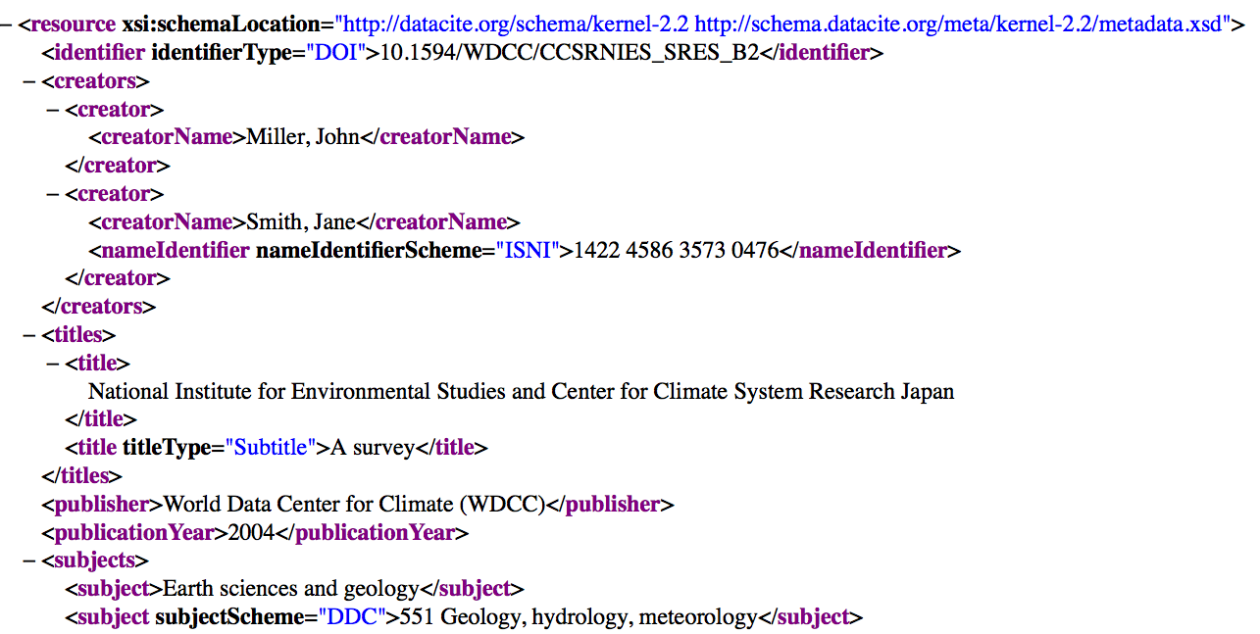

Slide 8
Structural Metadata
…indicates how compound objects are put together, for example, how pages are ordered to form chapters, or, how different observation events were combined for a “set” of data observations, etc.

Slide 9
Example
METS

Slide 10
Administrative Metadata
…provides information to help manage a resource, such as when and how it was created, file type and other technical information, and who can access it.

Slide 11
Subsets of Admin. Metadata
Rights management metadata, which deals with intellectual property rights. (OFTEN EMBEDDED IN PRES METADATA)
Preservation metadata, which contains information needed to archive and preserve a resource.

Slide 12
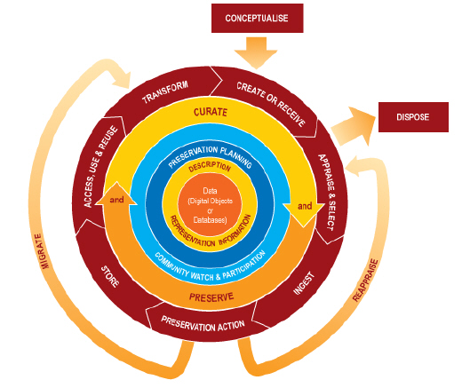
Notes:
Where in this lifecycle do we create metadata? Creating and recieiving data – ingesting into a new data management environment – any time we perform a preservation action we create metadata – and any time the data are reused, there is likely additional linkages to be created or maintained.
Different actors have different roles In the creation of metadata in this lifecycle

Slide 13
Who creates What metadata, and When…
Curators : When data are received / ingested, preservation actions are taken, after reuse occurs.
Type: Descriptive, Structural, and (esp) Admin
Data creators: When data are collected, transformed, reused.
Type: Descriptive + Structural
Notes:
What your metadata should describe, and when are subject of next module.

Slide 14

Evaluating and Selecting Metadata Schemas

Slide 15
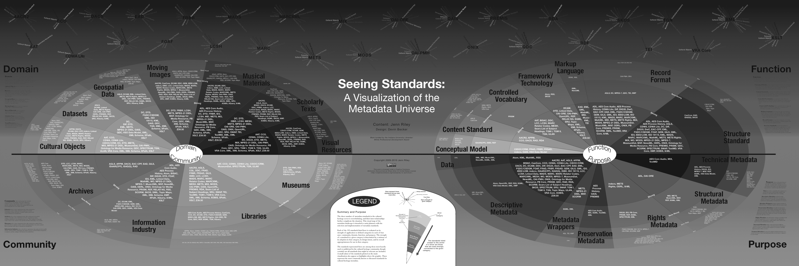
“The great thing about standards is that there’s so many of them”

Slide 16

And yet…

Slide 17
Why the proliferation?
No one-size-fits all standard
Local and community needs are heterogeneous and changing
Research data are hugely diverse!
Domain-specific needs are diverse!

Slide 18
How to evaluate and select from such a diverse range?

Slide 19
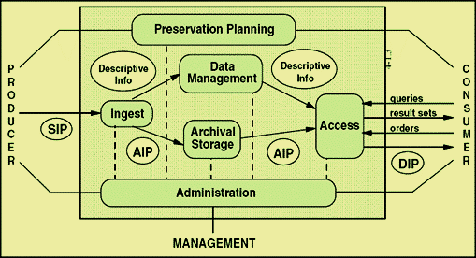
Producer vs. Manager vs. Consumer needs
Notes:
This can seem like a lot – so let’s reframe this according to one of the lifecycle models we looked at yesterday
Another way to divide types of metadata is by the groups of users it aims to serve

Slide 20
Manager (e.g. your) Needs
Before looking at schemas, articulate the “specificities” of your repository
What are your institution’s needs? What are the practical constraints of your work?

Slide 21
“Nine questions” for needs assessment
From Kennedy, 2008:
Who will be using the collection?
Who is the collection cataloguer?
How much time/money do you have?
How will your collection be accessed?
Notes:
Before we start looking at and comparing schemas its important to ask, “what’s the goal”
She’s not talking about data –
Still an emerging set of resources about data objects

Slide 22
Kennedy 2008 continued
How is your collection related to other collections?
What is the scope of your collection?
Will your metadata be harvested?
Do you want your collection to work with other collections?
How much maintenance or quality control do you wish?

Slide 23
Kennedy 2008 continued
How is your collection related to other collections?
What is the scope of your collection?
Will your metadata be harvested?
Do you want your collection to work with other collections?
How much maintenance or quality control do you wish?
Notes:
These questions point to the need to also evaluate consumer needs:

Slide 24
Consumer needs
Notes:
Also

Slide 25
Something on assessing community needs

Slide 26
Interoperability

Slide 27
Harvesting protocols
Z39.50
ISO 19115
TAPIR, DIGIR

Slide 28
ICOADS dataset in 2 repositories
Notes:
Note that these are equally flawed, too…
Talk more about trade offs and affordances here
GCMD is broader, RDA is more specific (narrower Designated community)
Then show XML
Decision of what attrinbute value pair to use has a real consequence

Slide 29
Every point of transfer = point of potential data loss

Slide 30
Standards (and your ability to implement them) will always have limitations
Expressivity
Interoperability
Local needs
Community needs

Slide 31
Crosswalking, reconciliation and propagation

Slide 32
How would we aggregate these records?
100 a Shakespeare, William d 1564-1616
245 a The Tempest
260 a London: b Arden Shakespeare, c 1999
<dc:creator>Shakespeare, William, 1564-1616</>
<dc:title>Hamlet</>
<dc:publisher>Penguin Books</>
<dc:date>2003</>

Slide 33
Or move this one into a more general repository?
Notes:
Note that these are equally flawed, too…
Talk more about trade offs and affordances here
GCMD is broader, RDA is more specific (narrower Designated community)
Then show XML
Decision of what attrinbute value pair to use has a real consequence

Slide 35
GCMD Result
Notes:
Note that these are equally flawed, too…
Talk more about trade offs and affordances here
GCMD is broader, RDA is more specific (narrower Designated community)
Then show XML
Decision of what attrinbute value pair to use has a real consequence

Slide 36
GCMD Result
Notes:
Note that these are equally flawed, too…
Talk more about trade offs and affordances here
GCMD is broader, RDA is more specific (narrower Designated community)
Then show XML
Decision of what attrinbute value pair to use has a real consequence

Slide 37
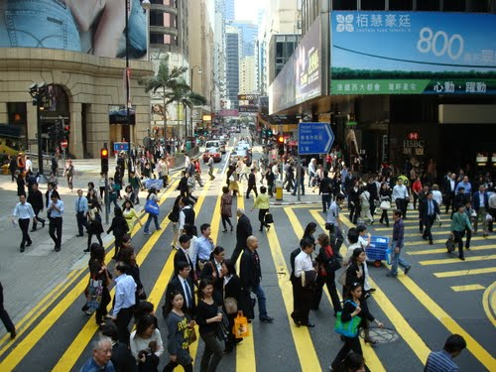
Crosswalking
Brings overlapping standards together
Necessary for aggregation and integration
Important but tricky
Notes:
As a result of the high amount of specificy for each repository and data center, when bringing records together, or publishing to more general repositories, there’s a need to translate, (or crosswalk) one standard into another.

Slide 38
A more familiar example
CDWA | MARC/AACR | MODS | Dublin Core
Catalog Level | 655 Genre/Form 300a Physical Description - Extent | <genre> <extent>
Object/Work Type | 655 Genre - Form | <genre> | Type
Components/Parts | 300a Physical Description - Extent | <extent> | Format.Extent
Classification Term | 050 084 "Other classification number" | <classification> | Subject (classification schema)
Title Text | 24Xa Title and Title - Related Information | <classification> | Subject (classification schema)

Slide 39
TWO MORE SLIDES – domain specific examples

Slide 40
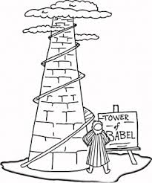
Crosswalking research data
“Push”: Darwin Core published through IPT
“Pull”: ICOADS in RDA harvested by GCMD

Slide 41
Crosswalking research data
Can be more complicated
Unit conversion
Idiosyncratic controlled vocabularies
Can be “lossy”

Slide 42
How does this:
Become this:
?

Slide 43
Data “friction”
“Every movement of data across an interface comes at some cost in time, energy, and human attention. Every interface between groups and organizations, as well as between machines, represents a point of resistance where data can be garbled, misinterpreted, or lost…
…data friction consumes energy and produces turbulence and heat – that is, conflicts, disagreements, and inexact, unruly processes”

Slide 44
Finding “friction” by examining completeness & coverage
Searched for “mola mola”
Evaluated every version of the “same” specimen record published/harvested through different services
KUBI local website
GBIF
VertNet

Slide 46
Losses:
Size/“lifestage”: larva
Difference: 1mm vs. 4 m!

